Slide 1

DriverPass System Analysis
Adam Sissoko
Notes:
[No speaker notes required for this slide.]

Slide 2

System Requirements
Functional Requirements:
The system needs to provide the user with a list of available session times, so that they can book sessions quickly and efficiently.
The system needs to authenticate user credentials before allowing them to access their account.
Non-Functional Requirements:
The owner of DriverPass needs to be able to access system data from any platform he wants. (Computer, Mobile Device, etc.)
The system will have to be hosted on a cloud-based hosting service, rather than a physical server.
Notes:
[In your speaker notes, include an explanation of the different requirements you determined for DriverPass’s system. What are the functional requirements you selected to describe? What are the nonfunctional requirements you selected to describe? Be sure to explain how these requirements meet DriverPass’s needs.]

Slide 3
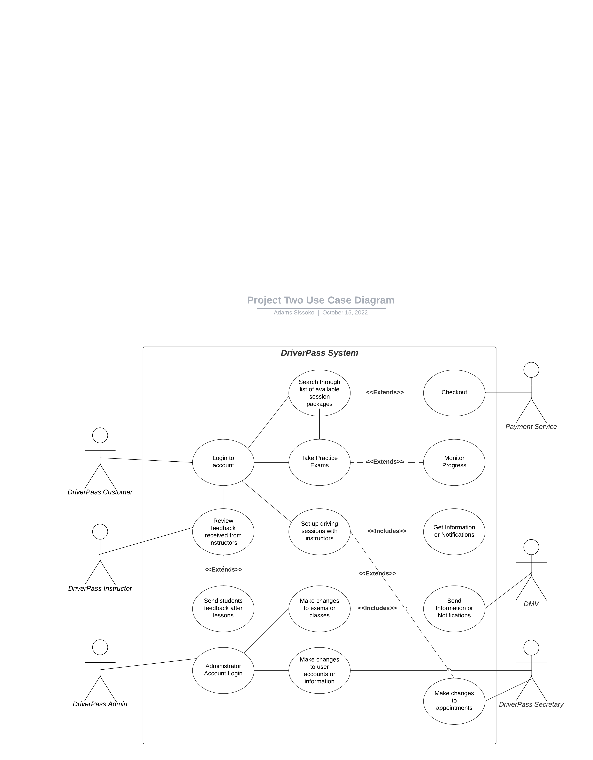
Use Case Diagram
Notes:
[Explain your diagram. Who are the different actors in the system? What are the different use cases? How did you account for DriverPass’s needs in your design? In your explanation, keep your audience in mind. Avoid the use of terms like “actors” and “use cases” in your explanation.]

Slide 4
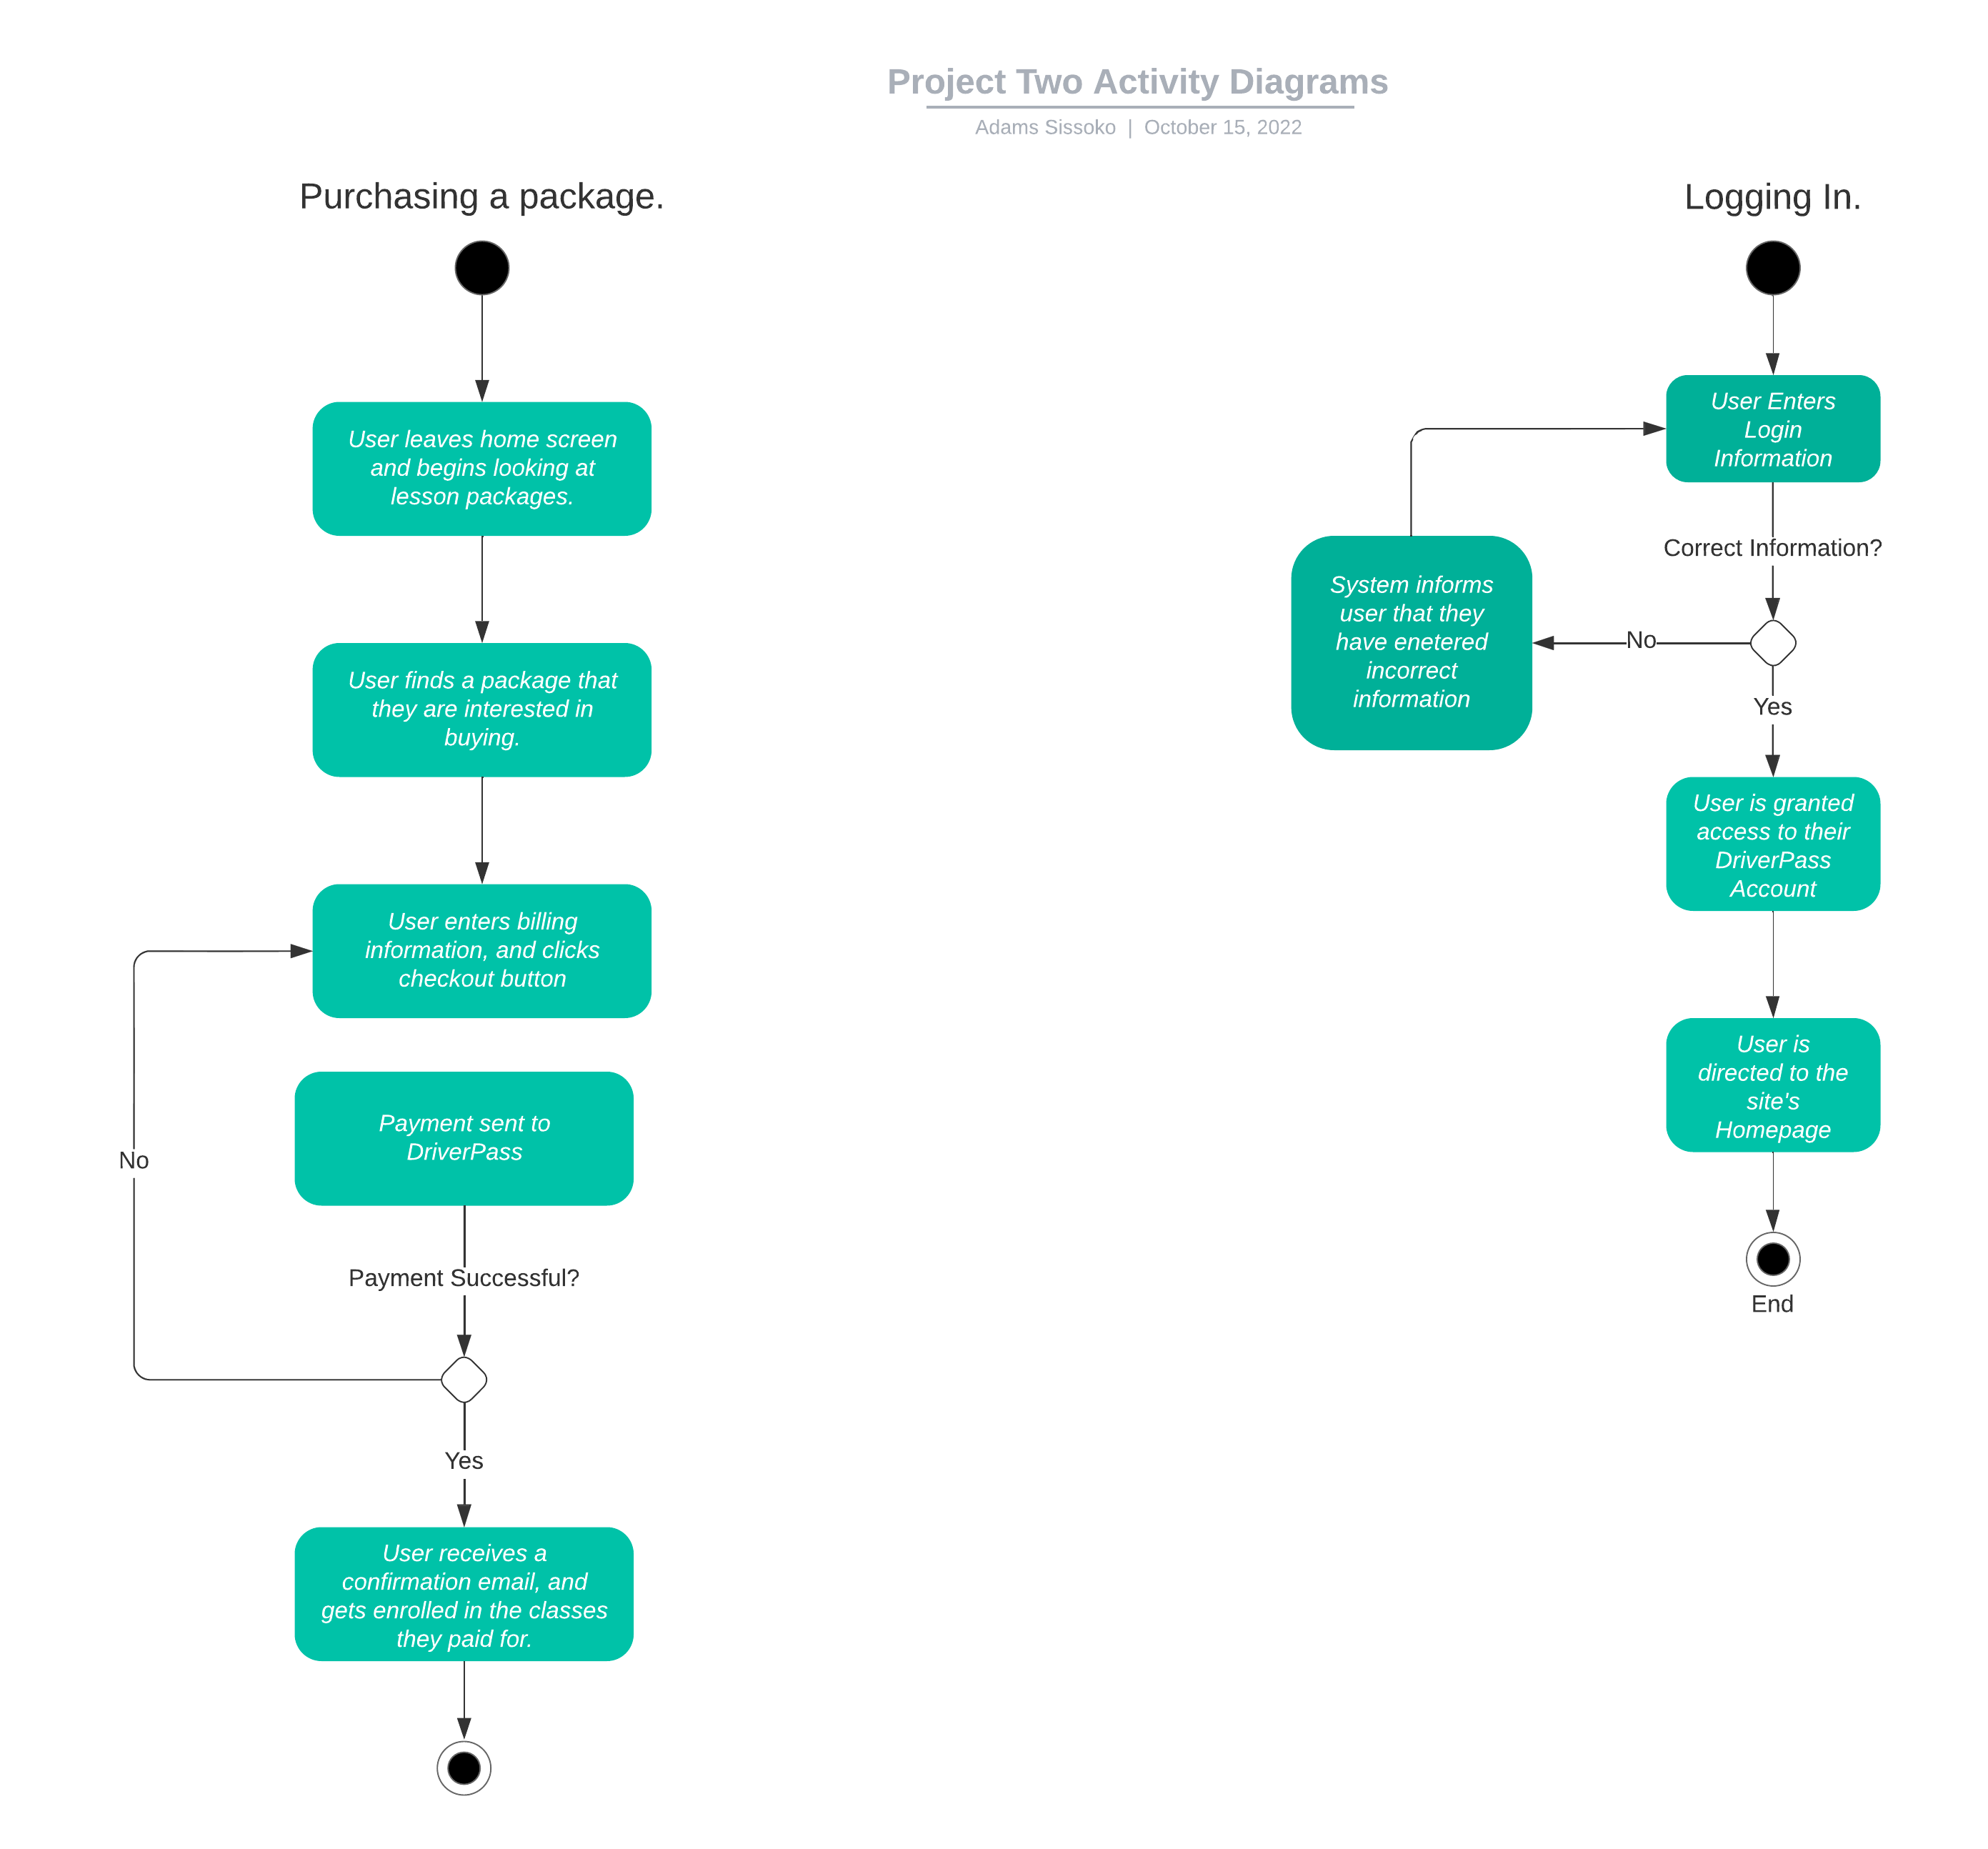
Activity Diagram
Notes:
[Explain your diagram. Which use case are you breaking down? What are the steps for this use case? How did you account for DriverPass’s needs in your design? In your explanation, keep your audience in mind. Avoid the use of technical terms such as “nodes,” “control flows,” and so on.]

Slide 5
Security
If a customer attempts to use the wrong login credentials multiple times, they will be warned. If they continue, they will be locked out of their account for a small period of time. This time period will progressively increase if the user continues trying to use incorrect credentials.
When users struggle to remember their login credentials, they will be given the option to reset their password, and the DriverPass team will send them a link to a site where this can be done.
The customers will need to enter a username and case-sensitive password in order to access their accounts and personal information.
The customer’s connection to the site will be encrypted to prevent malicious attacks and stop user data from being compromised.
Notes:
[How did you consider security in your design? In your explanation, keep your audience in mind by avoiding the use of technical terms.]

Slide 6
System Limitations
The development team only has three months to complete the entire system and implement all the features that DriverPass asked for.
When users forget their password, they’ll be reminded, but this may not be the case for their usernames.
The customers won’t be able to choose which instructor they get for their driving sessions., meaning they may end up being paired with instructors that they don’t want to work with.
The consulting company isn’t very large, so they won’t have access to some of the resources that a larger company might have. There will be a very limited development budget, and a limited number of employees that can work on features for the website at any given time.
Notes:
[What are the limitations of your design? In your explanation, keep your audience in mind by avoiding the use of technical terms.]

